Slide 1
Template Design Pattern
Brett Recker
Radwan Albadawi

Slide 2
Story
In software engineering the template method pattern is a behavioral design pattern that defines the program skeleton.
Used to create a GROUP of subclasses that have EXECUTED SIMILAR group of methods
Serious methods calls that every subclass object will call

Slide 3
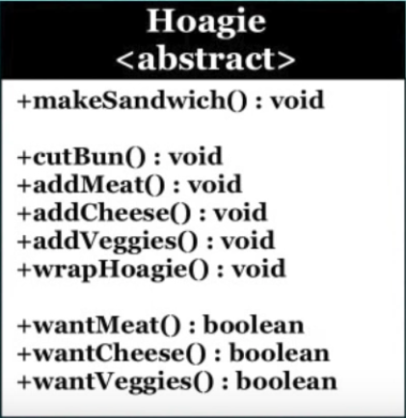
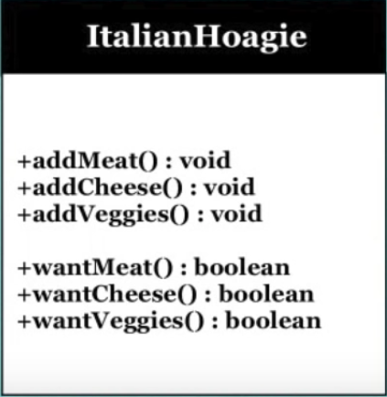
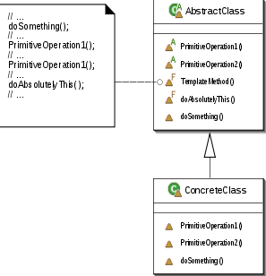
UML Design
Notes:
MakeSandwich() is a template method here, it defined in the abstract class the second example shows more explanation that the template method have some calls the subclass will be using use

Slide 4
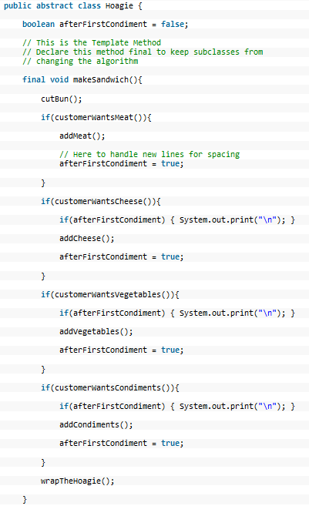
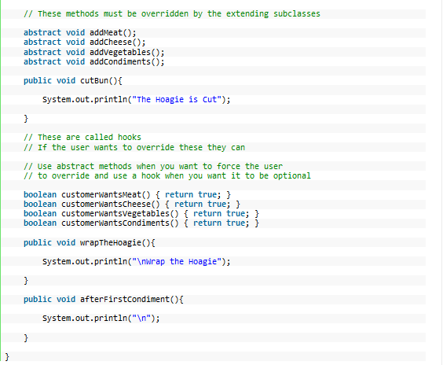
Code

Slide 5
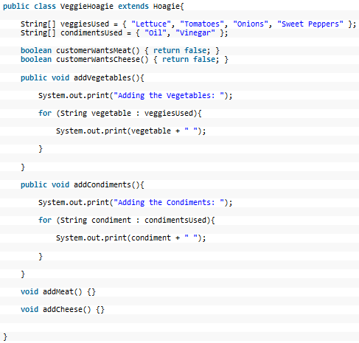
Code

Slide 6
Quiz
Subclass objects can’t override some of the template method call. (True/False)
The template method cannot be define in the abstract class. (True/False)
Why don’t we need template method if the subclasses will not be making similar calls?
Notes:
False it can override
False we define it in the abstract class.
Because we won’t be using it, the reason of the template method is to be used for a group of subclasses that calling similar calls.

Slide 7
Sources
Template Design Pattern By: Derek Banas @newthinktank.com
Template Method Pattern Wiki

